Slide 1





E-COMMERCE PRODUCT ANALYTICS
SARANYA R
MAY-2025

Slide 2

TABLE OF CONTENT
1
INTRODUCTION
6
UNSUPERVISED LEARNING
2
WEBSCRAPING
7
SUPERVISED LEARNING
3
DATA CLEANING
8
HYPERPARAMETER TUNING
4
DATA EXPLORATORY ANALYSIS
9
ENSEMBLE LEARNING
5
DATA STORAGE
10
CONCLUSION

Slide 3




INTRODUCTION
As part of a growing e-commerce company, you have been tasked with analysing product data to better understand market trends and customer preferences.
objective is to leverage data science techniques to enhance the company's product offerings and marketing strategies.
This project will involve collecting data, performing analysis, and using machine learning to derive actionable insights.

Slide 4


WEBSCRAPING
The primary objective of the data acquisition phase was to compile a foundational dataset of mobile phones from major Indian e-commerce platforms.
FLIPKART
CROMA
AMAZON INDIA
RELIANCE DIGITAL

Slide 5
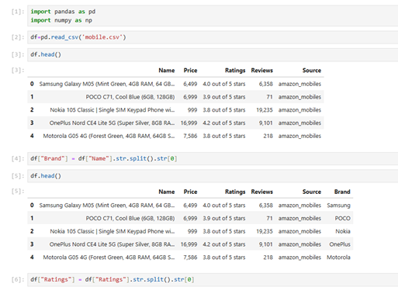
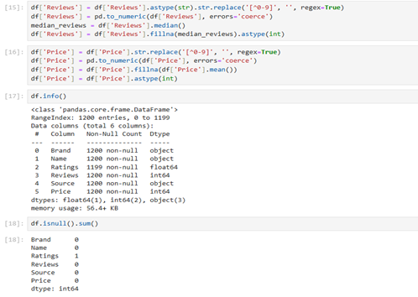
DATA CLEANING
Data Cleaning & Transformation – Extracted structured information (e.g., Brand from Name), standardized formats (numeric/string), handled missing/invalid values, and removed extra text/characters from Price, Ratings, and Reviews to ensure data integrity.
Final Dataset Readiness – Verified with df.info() and df.isnull().sum() that all 1200 entries had correct data types (Ratings: float64, Reviews & Price: int64, categorical columns as object) and no missing values, resulting in a clean, structured dataset for EDA and machine learning.

Slide 6
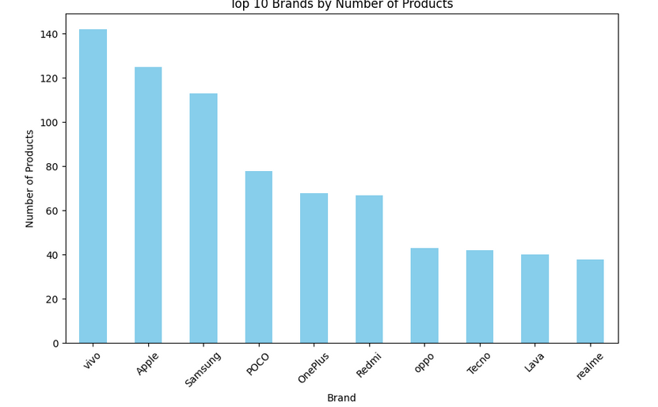
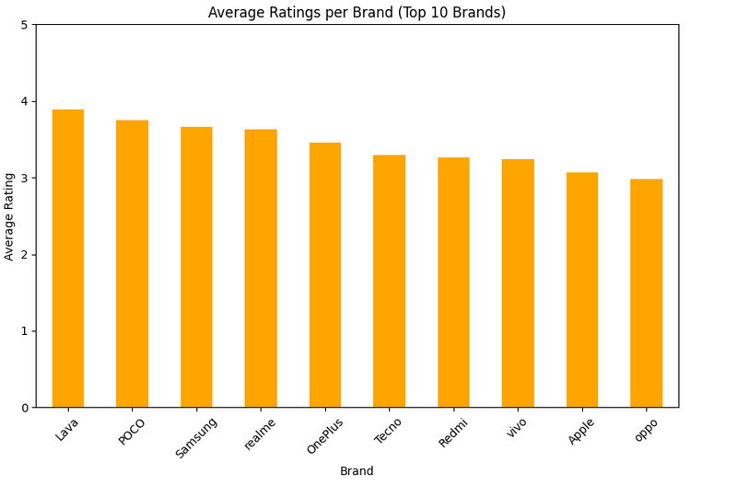
DATA EXPLORATORY ANALYSIS
Vivo leads the market with the highest number of products (~142), showing strong portfolio diversity.
Apple and Samsung follow closely, with Apple (~125) slightly ahead of Samsung (~113).
Lava has the highest average rating, close to 3.9, making it the best-rated brand among the top 10.
POCO, Samsung, and Realme also have high average ratings ranging between 3.6 and 3.8, showing consistent customer satisfaction.
The majority of phones are priced between ₹5,000 and ₹30,000.
Very few phones exceed ₹100,000, and even fewer reach up to ₹200,000.

Slide 7
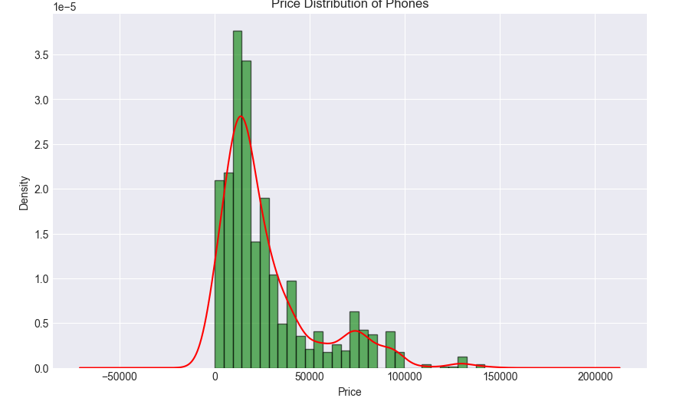
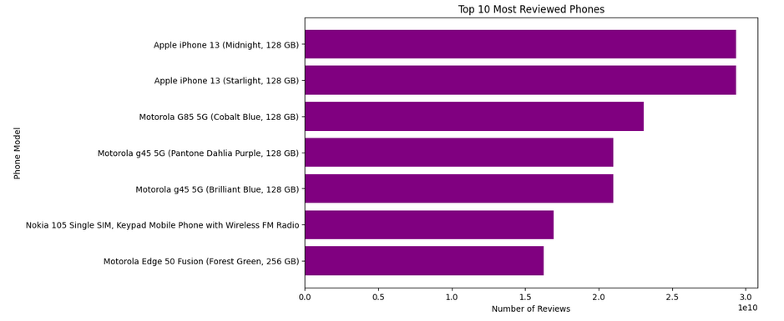
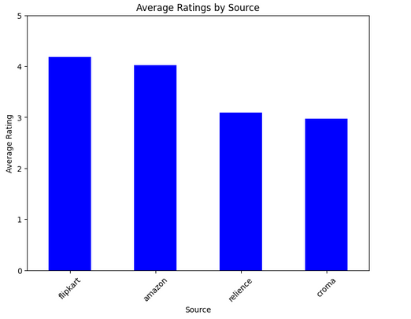
DATA EXPLORATORY ANALYSIS
Apple iPhone 13 (Midnight, 128 GB) and iPhone 13 (Starlight, 128 GB) are the two most reviewed phones by a significant margin.
These models have almost 30 billion reviews each.
Flipkart leads with the highest average rating (~4.2), indicating stronger customer satisfaction compared to other sources.
Amazon follows closely with an average rating of ~4.0, showing consistent reliability and customer trust.

Slide 8



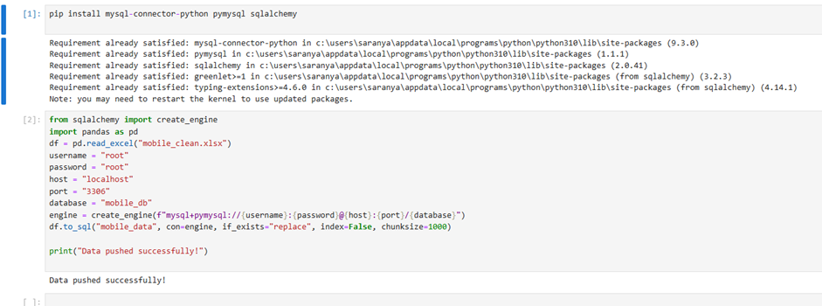
DATA STORAGE
MYSQL Databases ensure durable storage, integrity, scalability, security, and efficient querying, making them reliable for managing and analyzing large, sensitive datasets.

Slide 9

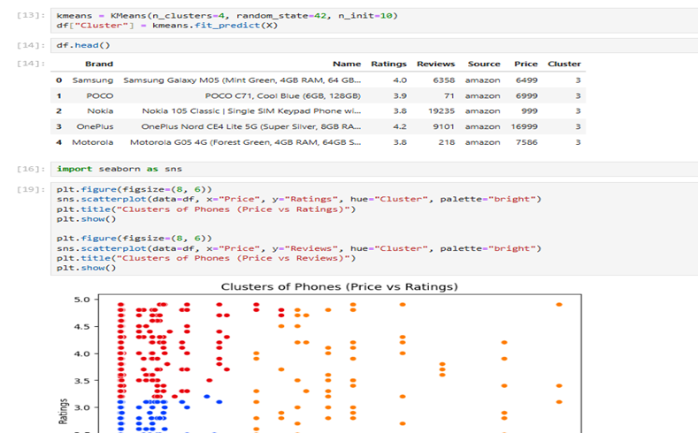
UNSUPERVISED
LEARNING
K-Means clustering was selected for this task due to its efficiency, simplicity, and interpretability.
The algorithm partitions data into k clusters by minimizing the within-cluster variance (inertia). Each cluster is defined by its centroid, and data points are assigned to the nearest centroid.

Slide 10
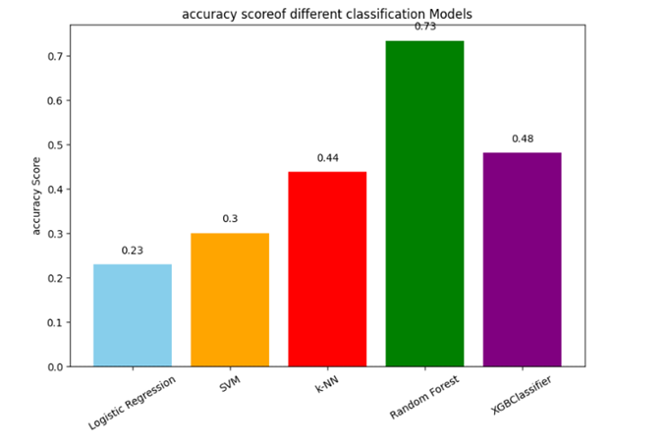
SUPERVISED LEARNING
Model Performance Summary
Model Accuracy Score
1. Logistic Regression 0.23
2. SVM 0.30
3. k-NN 0.44
4. Random Forest 0.75
5. XGBClassifier 0.58

Slide 11

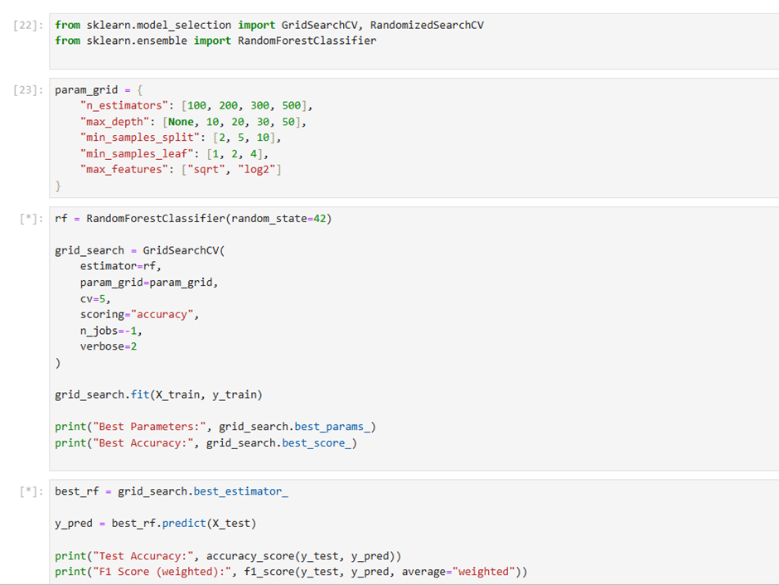
HYPERPARAMETER TUNING
Random Forest underwent a comprehensive hyperparameter tuning, using a detailed parameter grid search for optimization.
Despite tuning, the model’s accuracy remained 0.75, identical to the performance before hyperparameter optimization.
Compared models showed lower performance, with k-NN achieving 0.44 and SVM and Logistic Regression at 0.30 and 0.23 respectively.

Slide 12
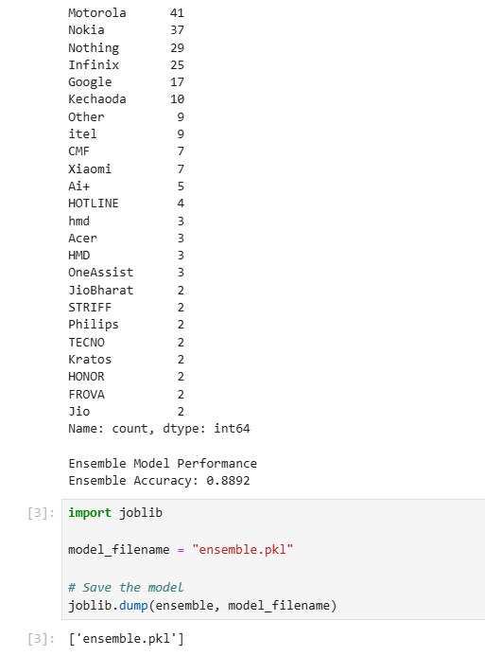
ENSEMBLE LEARNING
Random Forest underwent a comprehensive hyperparameter tuning, using a detailed parameter grid search for optimization.
Despite tuning, the model’s accuracy remained 0.75, identical to the performance before hyperparameter optimization.
Compared models showed lower performance, with k-NN achieving 0.44 and SVM and Logistic Regression at 0.30 and 0.23 respectively.

Slide 13

THANK YOU

